Slide 1
SHIFT HANDOVER REPORT
It is a document that records the handover of daily duties and responsibilities from one shift team to the next.
Updating active Incidents, Ritms and Change requests.
Including Edge nodes of both production and development clusters

Slide 2
What should we include in Shift handover report?
Incidents
Change Requests
Ritms
The above three are the types of tickets in service now
We need to add only active tickets in shift handover report
Tickets those are work in progress and validation tickets to be included.

Slide 3
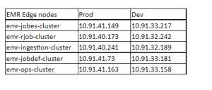
What are the Edge nodes added in Shift handover report?

Slide 4
Why are we using Edge nodes in Shift handover report?
We can connect to servers using edge nodes
Edge node have static Ip's that means Ip's will not change
We can perform only hive tables unlocking as we don't have root access

Slide 5
We are using shift handover report for updating present activities to next shift members, activities such as active incidents, ritms and change request and we need to mention them clearly what are the current active issues also.
Thank you

